Slide 1






Investing in 2nd Tier European Football League
Boping Liu and Jungmo Kim

Slide 2

Scenario
Online Streaming Service in South Korea looking to expand into sports programming - European Football
Broadcasting rights for the large and most popular leagues (EPL, La Liga, Bundesliga, Serie A, Ligue 1) already owned by other networks
Evaluate 2nd tier European Football leagues to see which one would bring best value for football fans

Slide 3
Scottish Premier League
Dutch Premier Division
Swiss Super League
Belgian Jupiler Pro League
Liga
Portugal
Polish PKO
Pro League

Slide 4

Data Driven Approach
Gauge entertainment of different leagues analytically using following metrics
Total goals scored per match
Number of scoreless matches per week
Average players ratings per match
Average player potential per match

Slide 5

Data
Match data
Home/Away Teams
Season
League
Date/Match week
Goals scored (home/away)
League Data
Team Data
Players Data (EA Sports)

Slide 6



Data Summary
8 Season Analyzed (2008/2009 - 2015/2016)
Leagues: 6
Total Teams: 135
Total Matches: 11,382
Total Goals: 31,180

Slide 7
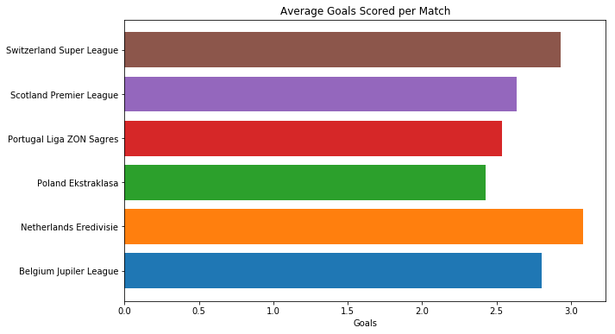

Slide 8
Goals Scored
Per Match
Results:
Dutch league matches on average has statistically more goals scored than other five leagues
While difference between Portuguese, Polish and Scottish leagues is significant, difference between Swiss and Belgian leagues are less pronounced
Use Dutch league (3.08) as benchmark for statistical tests
Determine if Dutch league matches has statistically more goals on average

Slide 9
Hypothesis Test
Goals per Match
Results:
P-Value and Cohen’s d table
H0: There is no statistical difference for goals scored per match between the Dutch league and other leagues
H1: There is statistical difference in goals scored per match with the Dutch league having more goals scored on average
Alpha Level = 0.05
League | P-Value | Cohen’s D
Belgium | ~0.0 | 0.1626
Switzerland | 0.0043 | 0.0873
Poland | ~0.0 | 0.3963
Portugal | ~0.0 | 0.3225
Scotland | ~0.0 | 0.2630

Slide 10
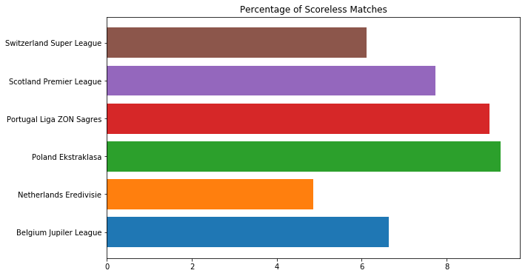

Slide 11
Scoreless Matches
Results:
Dutch league matches on average has statistically less scoreless matches than all other leagues
The practical difference is more pronounced compared to Polish and Portuguese leagues, but less so compared to Belgian, Swiss and Scottish Leagues
Use Dutch league (4.86) as benchmark for statistical tests
Determine if Dutch league matches has statistically less scoreless matches on average

Slide 12
Hypothesis Test
Scoreless Matches
Results:
P-Value and Cohen’s d table
H0: There is no statistical difference average scoreless matches between the Dutch league and other leagues
H1: There is statistical difference in number of scoreless matches with the Dutch league having less scoreless matches on average
Alpha Level = 0.05
League | P-Value | Cohen’s D
Belgium | 0.0113 | 0.2162
Switzerland | 0.0001 | 0.2975
Poland | ~0.0 | 0.4916
Portugal | ~0.0 | 0.4797
Scotland | 0.0001 | 0.2975

Slide 13
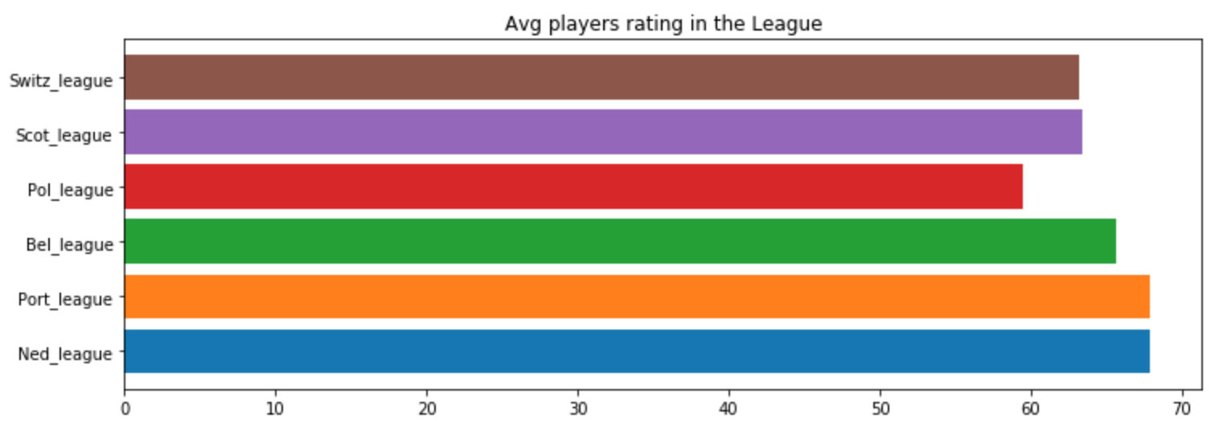
Players average rating per match in the league
Portugal league & Netherlands league have highest players average rating.
Poland league scores the lowest players average among the league.
Switz_league: 63.2
Scot_league: 63.4
Pol_league: 59.5
Bel_league: 65.7
Port_league: 67.9
Ned_league: 67.9
There were significant difference was found between Ned_league to other leagues except Portugal league
We are confident with our hypothesis by 99% with other leagues except Portugal league.

Slide 14
Hypothesis Test:
Ned vs other leagues:
There were significant difference was found between Ned_league’s avg players rating to other leagues except Portugal league
99% chance to reject null hypothesis on other league except Portugal league
Ho = no difference in highest avg players rating league to other league
Ha = highest avg players rating league have significant difference to other leagues

Slide 15
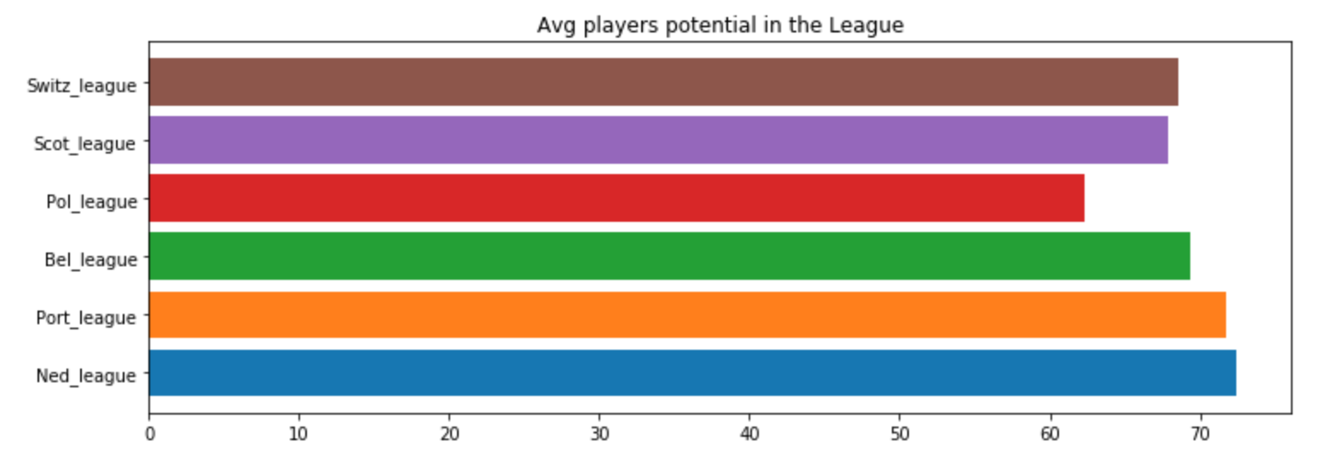
Players average potential per match in the league
Netherlands league has highest average players potential
Poland league scores lowest average players potential
Switz_league: 68.5
Scot_league: 67.8
Pol_league: 62.4
Bel_league: 69.4
Port_league: 71.7
Ned_league: 72.5
There were significant difference was found between Ned_league to other leagues
We are confident with our hypothesis by 99%

Slide 16
Hypothesis Test:
Ned vs other leagues:
There were significant difference was found between Ned_league’s avg players potential to other leagues
95% chance to reject null hypothesis
Ho = no difference in highest avg players potential league to other league
Ha = highest avg players potential league have significant difference to other leagues

Slide 17
Summary
Dutch League scores more goals on average per match, followed by Swiss and Belgian leagues
Dutch League has lowest average scoreless matches, followed by Belgian, Swiss and Scottish leagues
Dutch League and Portuguese league players have higher average rating than other leagues
Dutch League players have highest potential ratings
1

Slide 18

Recommendation
Pursue Dutch League (Eredivisie) as main lead
Look into other fundamental league factors (stars, club appeal, broadcasting rights acquisition logistics)
Keep Belgian and Swiss Leagues as secondary options
1

